Slide 1

WIN IF YOU CAN
HACKATHON
TEAM NAME: NOOB CODERS
TEAM LEADER NAME: DHRUV NAILWAL
INSTITUTION : DEPARTMENT OF COMPUTER SCIENCE
PROBLEM STATEMENT: Unseen-Customer Fraud Detection

Slide 2



WIN IF YOU CAN HACKATHON
fraud probability
Unseen-Customer
Fraud Detection
“New” must never be treated as “fraud.”
Team NOOB CODERS
novelty score

Slide 3






01 · THE PROBLEM
“New” is not “fraud”
≠
  Never-seen customers. Detection has to work when the customer has never appeared before
  Two questions, not one. Is this fraud-like? Have we seen this before?
  Judged on alert quality. Precision and recall at a fixed alert budget, with known and unseen cohorts reported separately. Accuracy is not the headline metric.
Is this
fraud-like?
Seen this
before?
fraud probability
novelty score
REAL CONSTRAINTS
Streaming
Data arrives continuously
One-pass
Score each transaction once
HEADLINE METRIC
Accuracy
Precision / recall @ fixed alert budget
Alert budget
Alert volume is capped
Plain language
Explanation on every call
Known
Unseen
reported separately
Team NOOB CODERS

Slide 4



02 · THE SOLUTION
Two signals, one safe decision
SIGNALS & GUARDRAILS
Escalate
Highest risk
  Calibrated fraud probability. LightGBM with isotonic calibration.
  Identity-free novelty score. IsolationForest with an ECDF.
  Novelty alone never escalates. A probability floor (p ≥ p_floor) is required.
  Budget-controlled. A controller hard-caps review and high-risk volume; every call carries plain-language factors.
Fraud probability →
Normal
No escalation
PER TRANSACTION
1
2
3
4
5
Novelty →
Validate
Features
Score
Band
Commit
Team NOOB CODERS

Slide 5







03 · HOW IT’S BUILT
One engine, leakage-safe by construction
ONE ENGINE, THREE INTERFACES
LEAKAGE-SAFE DESIGN
18 / 18 QA checks pass
FastAPI · /predict, /predict/batch
HistoryStore
streaming state
Streamlit dashboard
extract_features
pure · point-in-time
CLI · analyse_file.py
commit_row
always runs last
Streaming scorer
Identical code path across all three.
reports/leakage_report.json: zero leakage, with a parity re-check.
TRAINING · 9 STAGES
keep unseen customers and priors out of TRAIN
1
2
3
4
5
6
7
8
9
Unseen holdout
Time split
Train-only priors
History dropout
Train
Calibrate
Fit novelty
Persist store
Replay + eval
Team NOOB CODERS

Slide 6





04 · INNOVATION
Fair to unseen customers, and explainable
  Fair by design. Customers are held out from TRAIN; a legacy holdout plus a time split eliminates leakage.
  Novelty is not fraud, in policy. The matrix needs both signals before escalation, not just at the data level.
  Exact TreeSHAP. Native LightGBM contributions, with a perturbation fallback.
  Identity-free. Raw IDs are verified absent from model features (QA check I). Analysts read "these factors moved the score", not a verdict.
Velocity
History
Amount
Merchant
Time
Device
6 human families · contribution, never causation
Team NOOB CODERS

Slide 7


05 · PROTOTYPE & RESTRICTIONS
Working end to end, built offline
PROTOTYPE · ALL LIVE
BUILT OFFLINE · STILL BULLETPROOF
Training
CLI scoring
No internet at build time
Auto-detects LightGBM at runtime; falls back to HistGradientBoosting.
LIVE
LIVE
API + dashboard covered by QA (18/18)
REST API
Dashboard
LIVE
LIVE
No native pred_contrib
Perturbation estimate replaces exact TreeSHAP; same 6 families.
CLI DEMO · NO SERVER, 2,000-ROW CSV
Explanations still produced per transaction
2,000
52
46.5%
rows
alerts · 2.6% budget
unseen
Synthetic data, not a benchmark
Labelled illustrative; dataset-agnostic; IEEE-CIS adapter built and run.
Exports in 5 formats:
CSV
JSON
MD
TXT
PDF
Honest limits in README and docs
Team NOOB CODERS
6 / 8

Slide 8
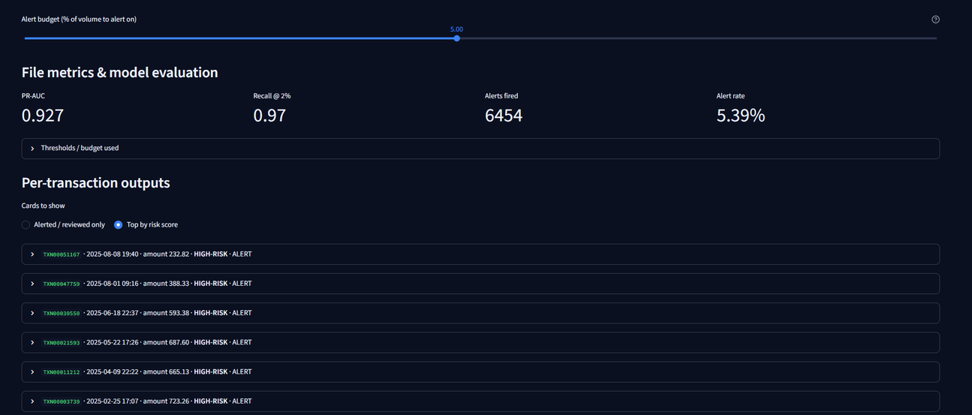
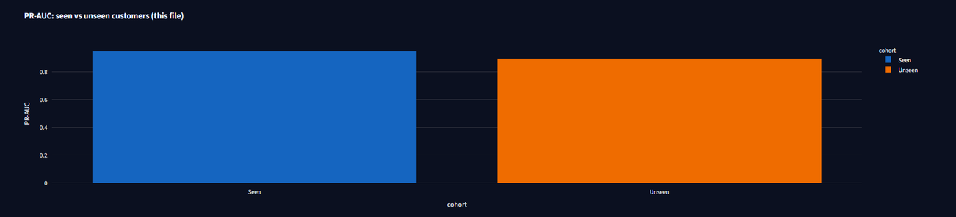
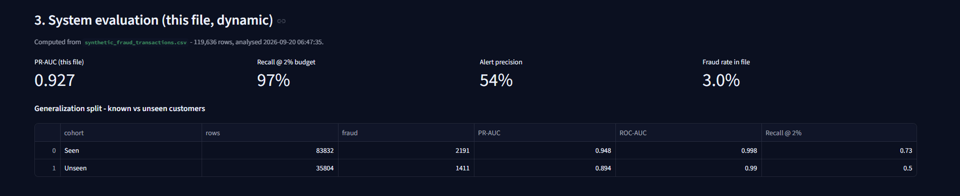
06 · PROTOTYPE VISUALS
Team NOOB CODERS

Slide 9
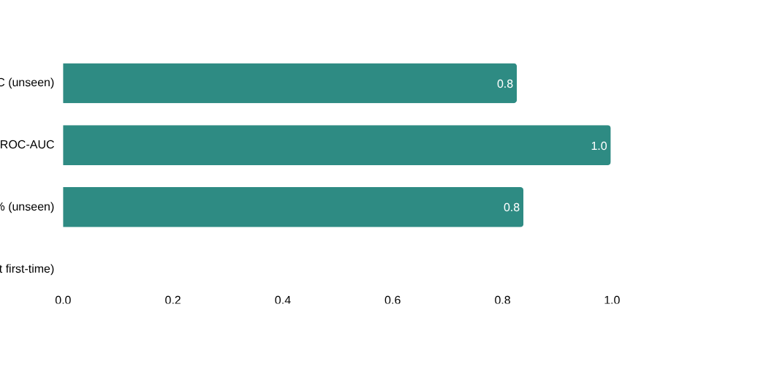


07 · KEY RESULTS
The numbers, honestly reported
SYNTHETIC · ILLUSTRATIVE
REAL · IEEE-CIS · HONEST
0.716
0.004
Calibration error (ECE)
1.68%
Alerts kept, share of volume
ROC-AUC
Scale 0–1 · baseline re-run confirms stability: PR-AUC 0.894, ROC-AUC 0.994
Streaming + calibration engine on a hard real dataset
60-txn burst
exactly 3 alerts
hard-capped in QA
Leakage cleared leakage_report.json + parity re-check
Proven on IEEE-CIS 300k rows, LightGBM, all 10 stages
Team NOOB CODERS

Slide 10


08 · TAKEAWAYS
Why this holds up
Novel ≠ fraud, enforced
Both signals are required before anything escalates.
HONEST LIMITS
  Synthetic results are illustrative, not a benchmark.
  Real IEEE-CIS data gives ROC-AUC 0.716: a hard dataset.
  Explanations show contribution, never causation.
Leakage-safe by construction
9-stage training, 18/18 QA checks, zero leakage reported.
Usable, explainable alerts
Budget-capped volume and plain-language factors on every call.
Thank you · Questions?
Team NOOB CODERS
Team NOOB CODERS

Slide 11
THANK YOU
TEAM NOOB CODERS :- VANSHIKA SHARMA
DHRUV NAILWAL
MAYANK TIWARI
JAHNAVI

